Slide 1

Dave Barter - What’s In Your FOSS Box?

Slide 2

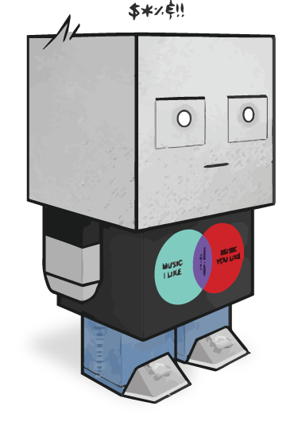
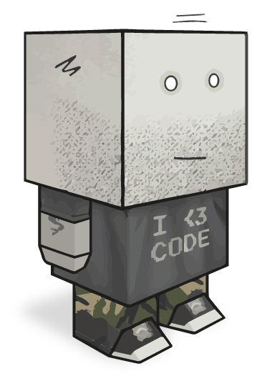

Slide 3

https://github.com/nautoguide/locaria

Slide 4
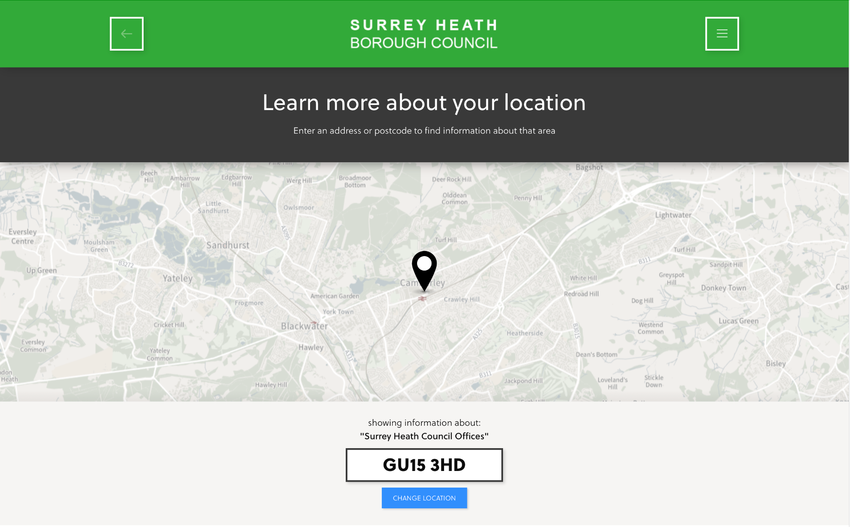
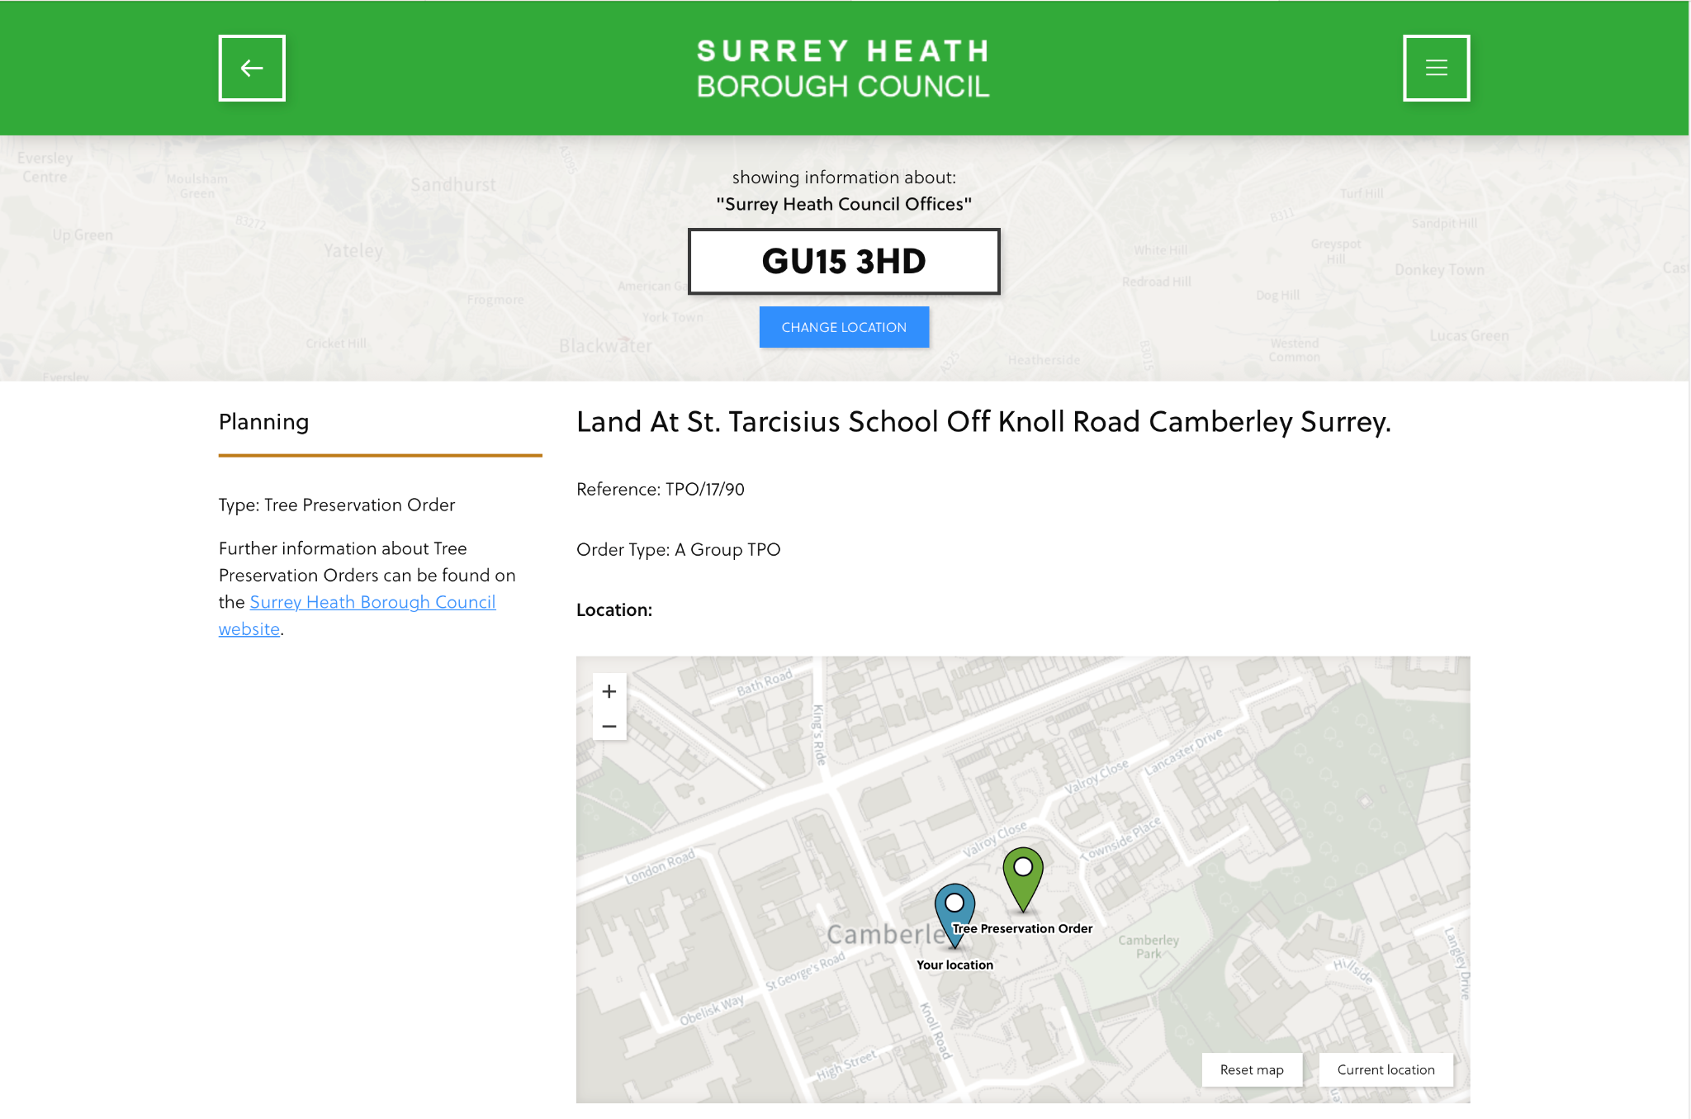
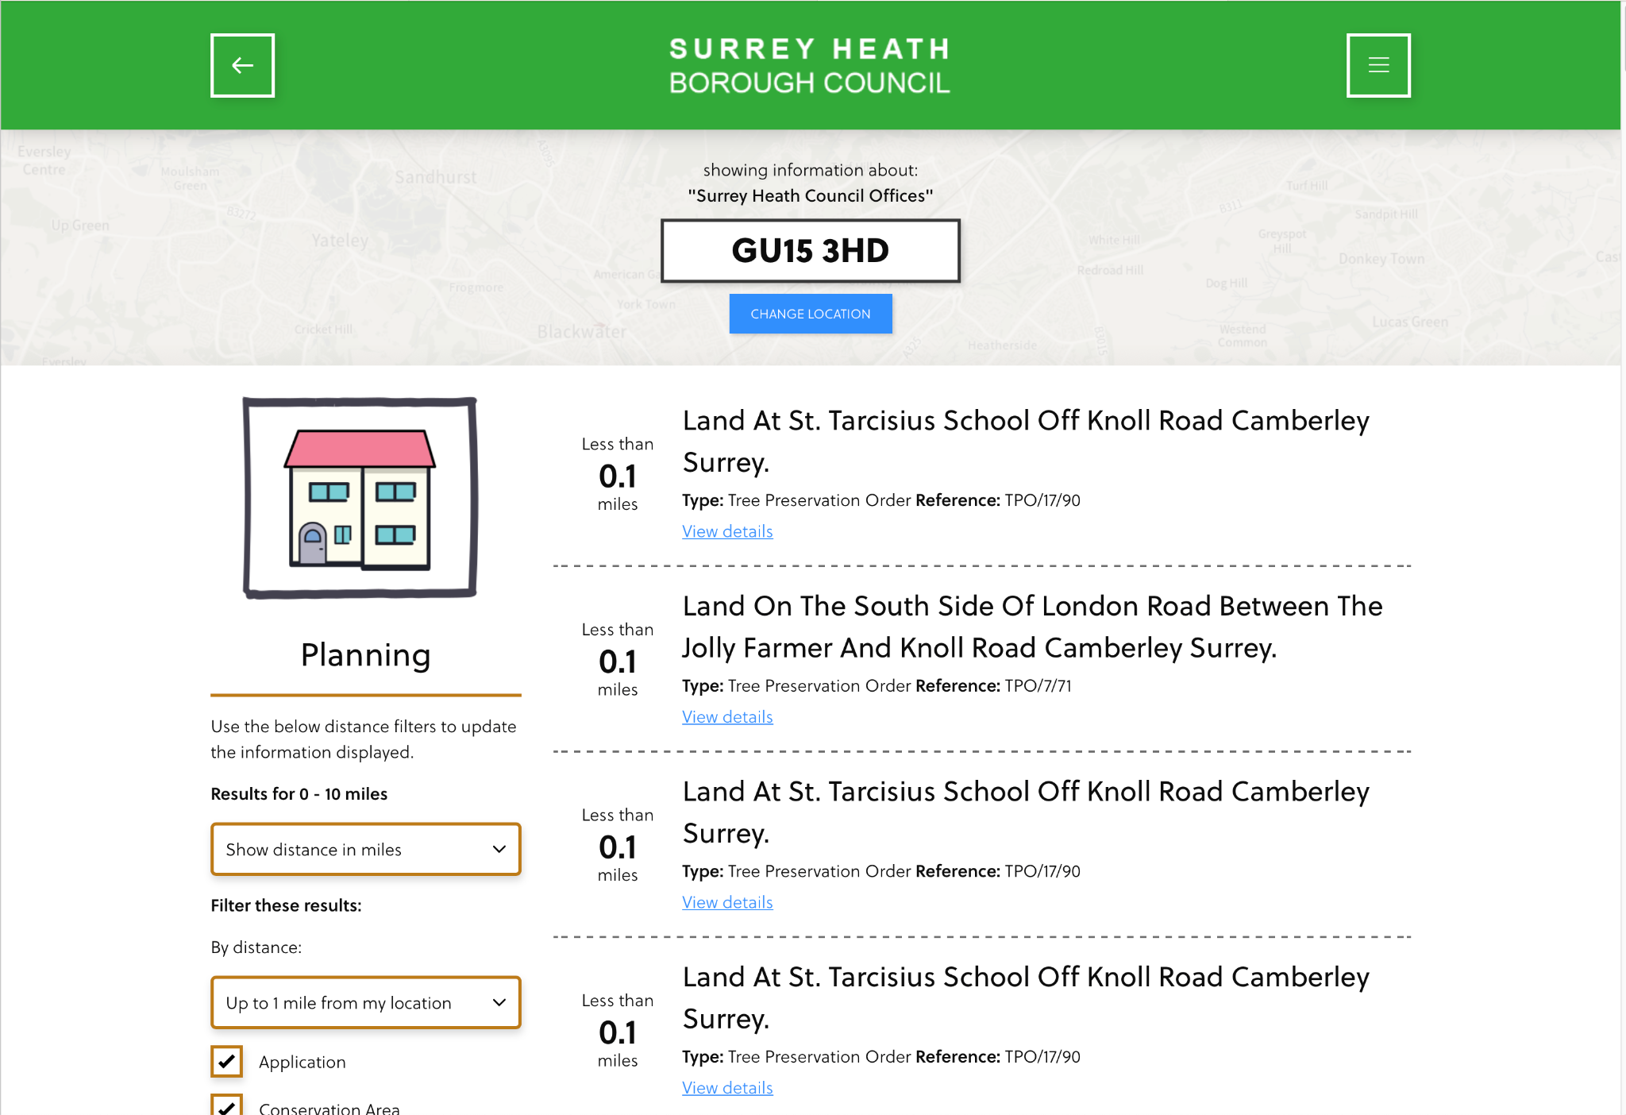

Slide 5
My FOSS Box ™

Slide 6







Slide 7
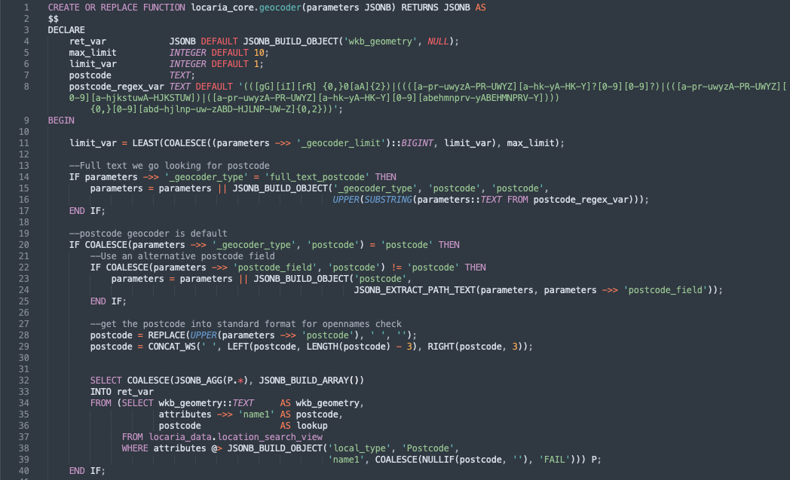
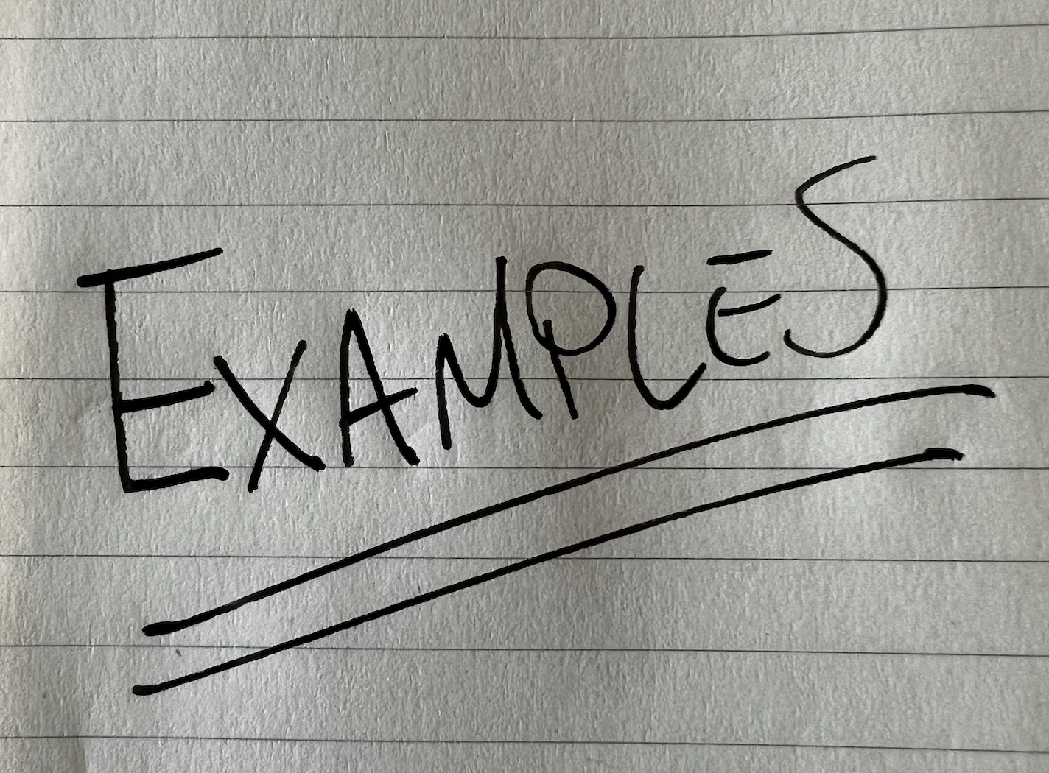
PostgreSQL Functions
Functionality in the database
In database API
Excellent json support
“Data only” testing
Reuse
Javascript (or perl/R/Python…)
Logging and error trapping
Extensions (pg_routing, pg_cron)

Slide 8
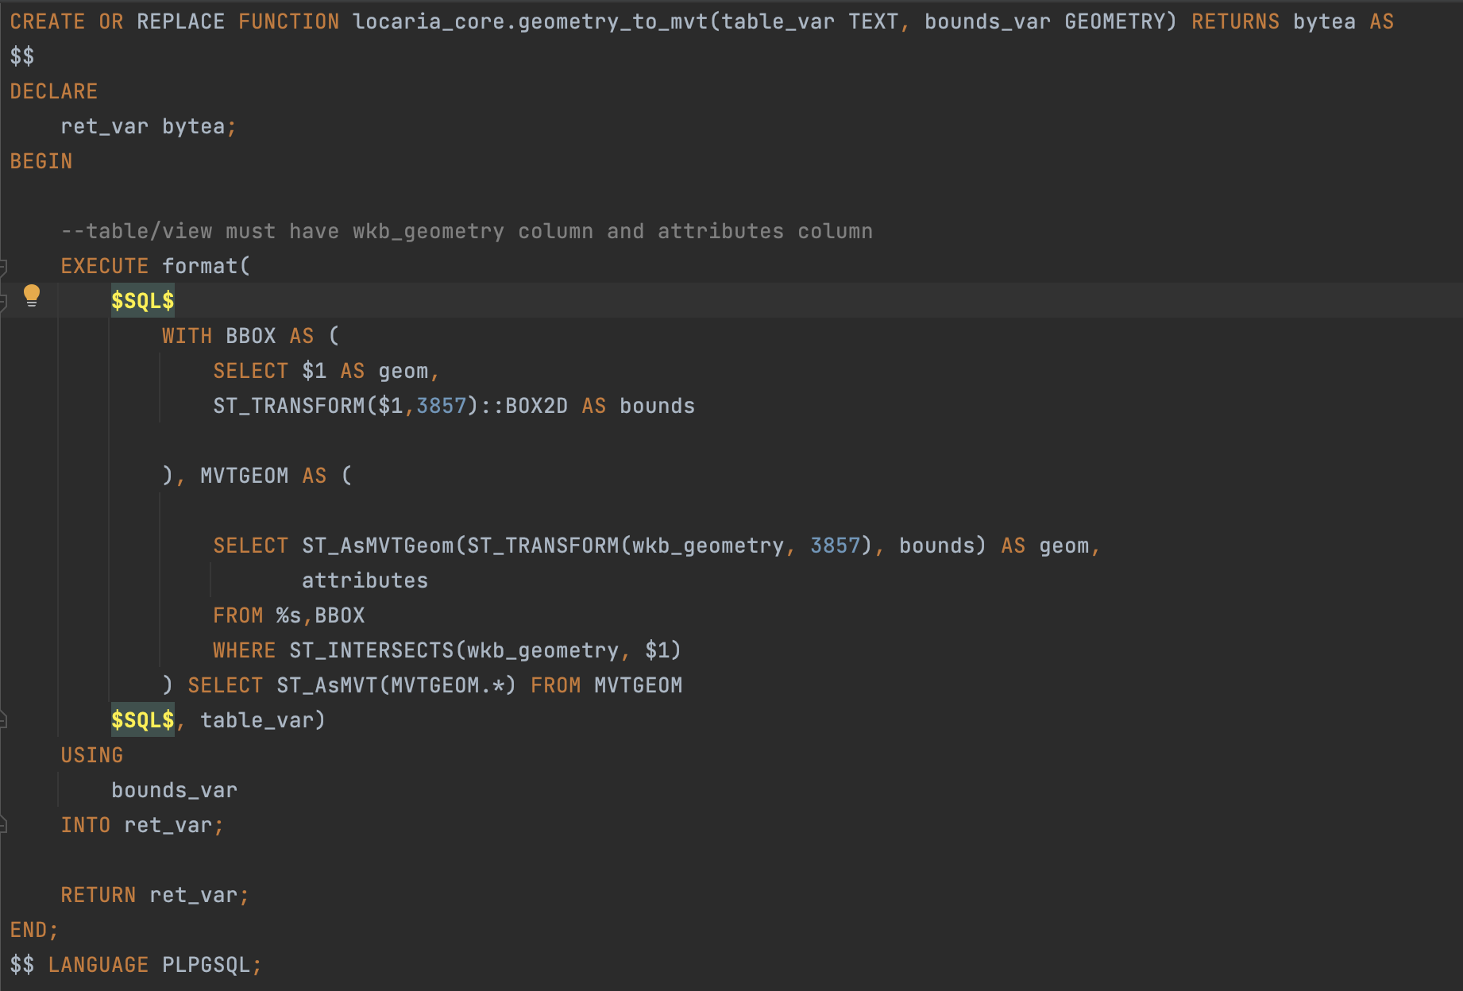
What “can’t” you do in PostGIS
Simplification
Proximity and BBox searches
Creation of Vector Tiles
Clustering

Slide 9
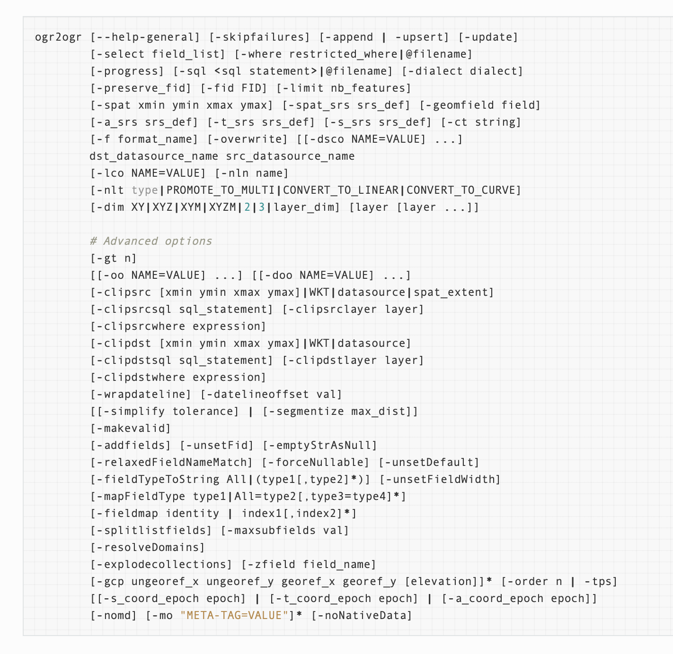
Geospatial data abstraction library
Loading data
Exporting data
Transforming data

Slide 10
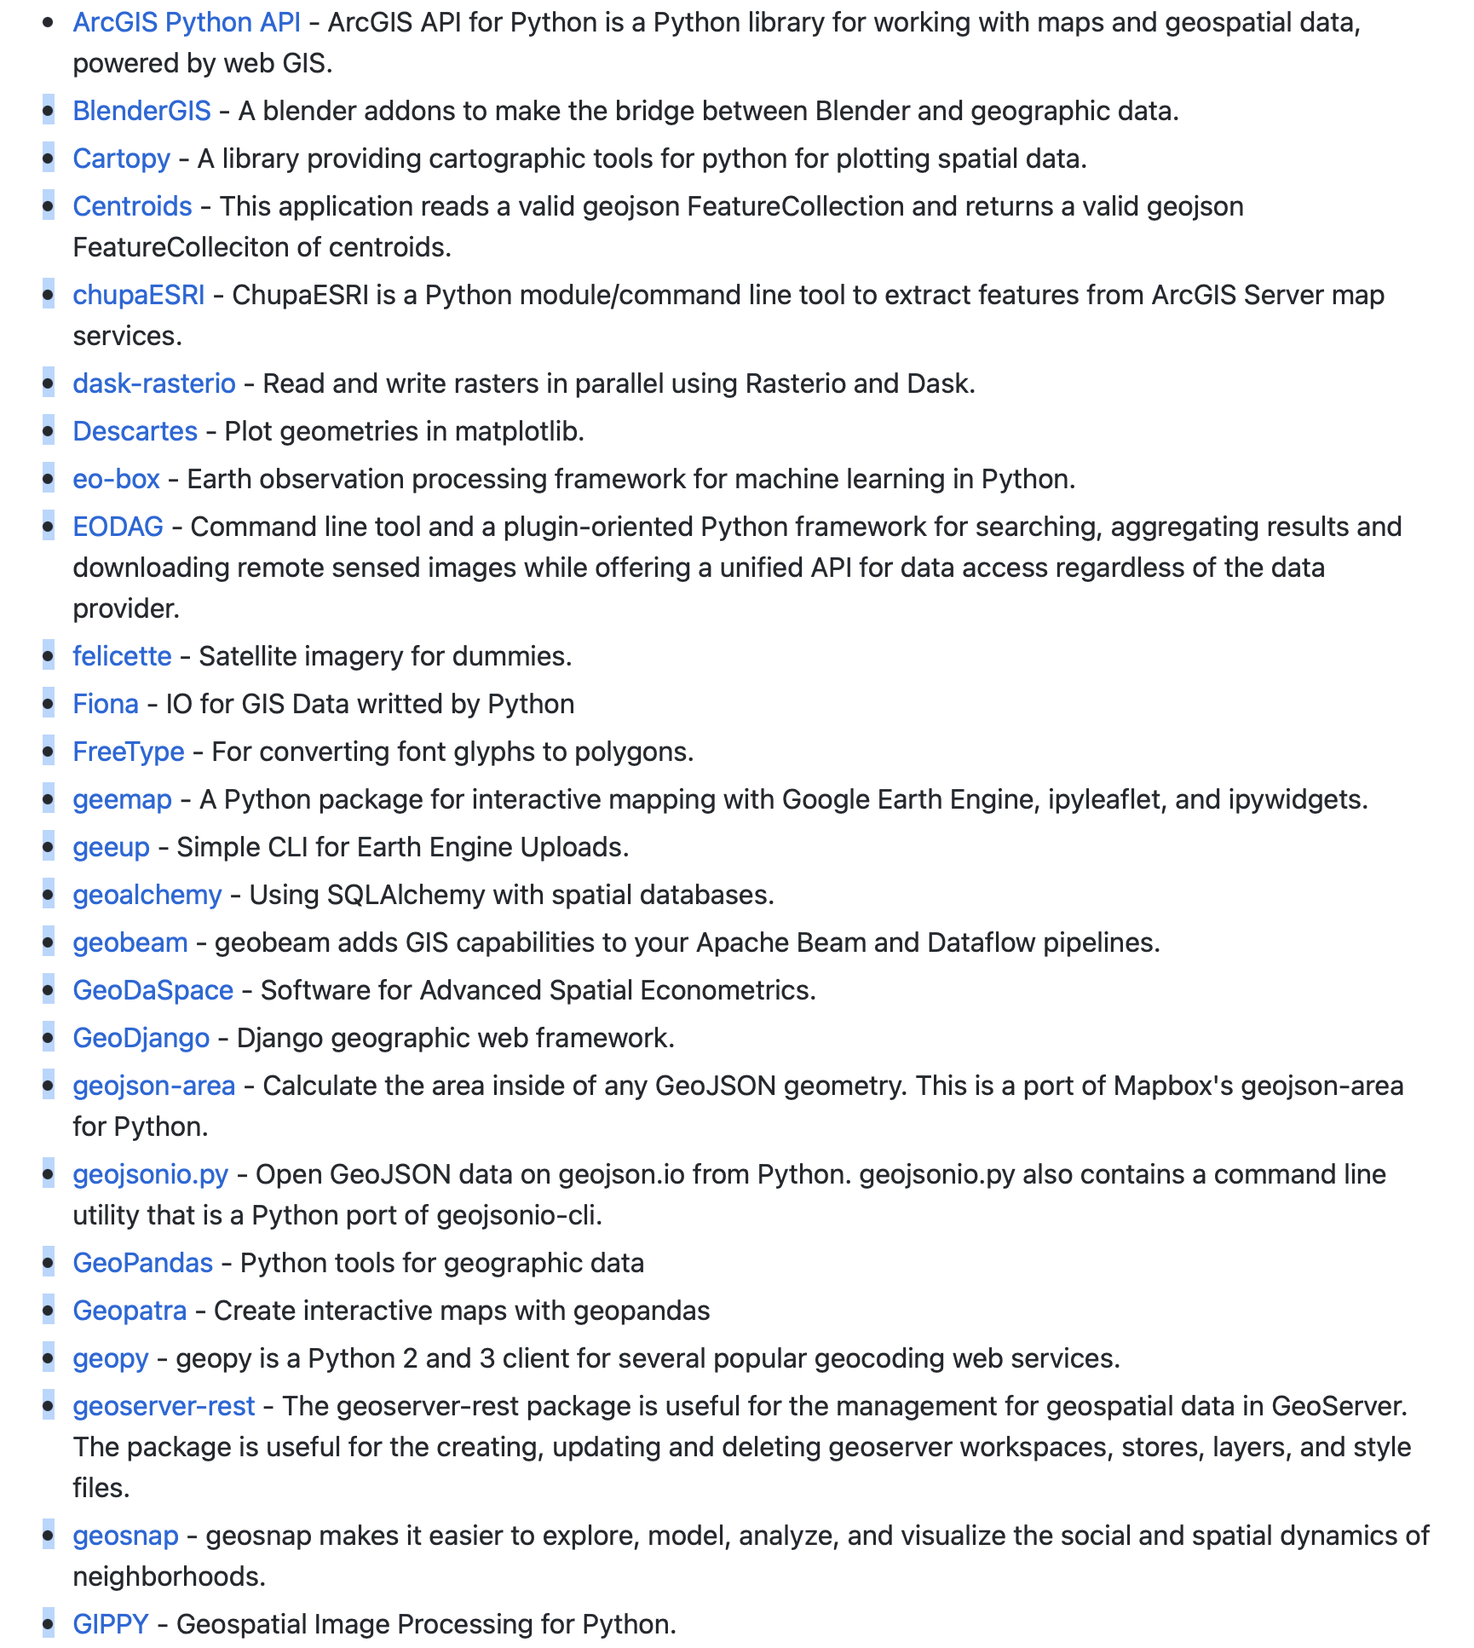
A language for Geo-spatialists
Pandas
Geopandas
90+ Python libraries

Slide 11
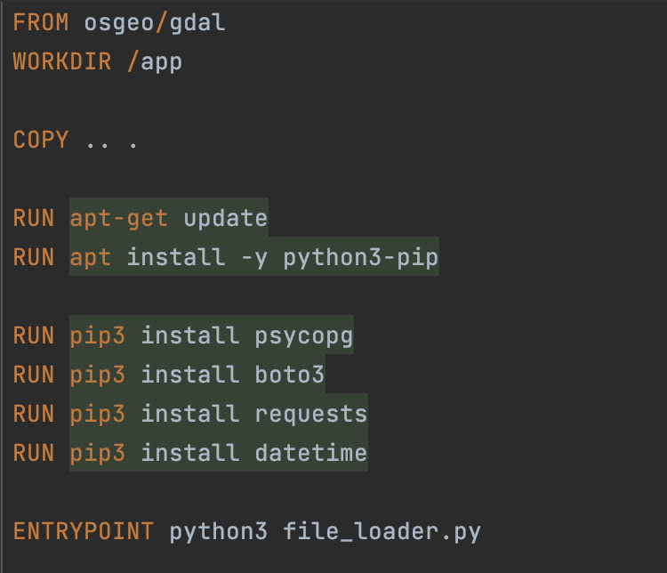
Managing dependency hell
Curated builds
Batch processing
Experimentation

Slide 12
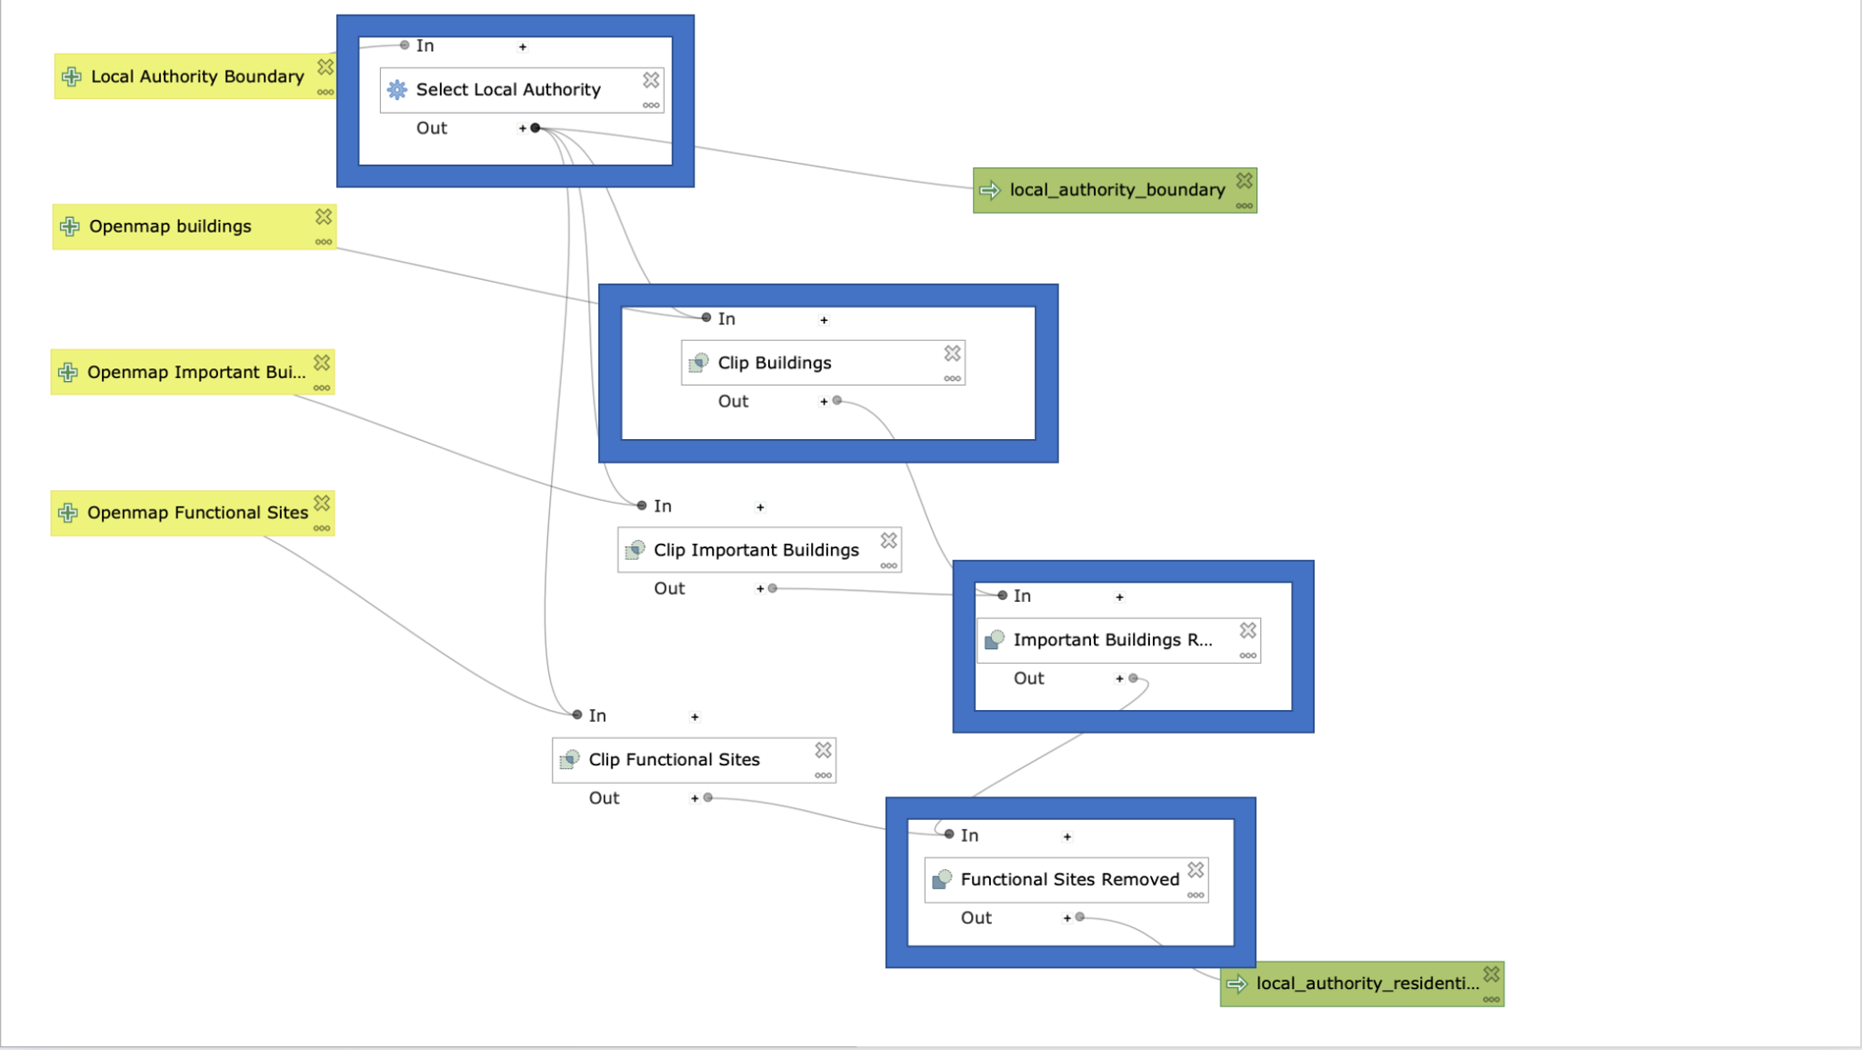
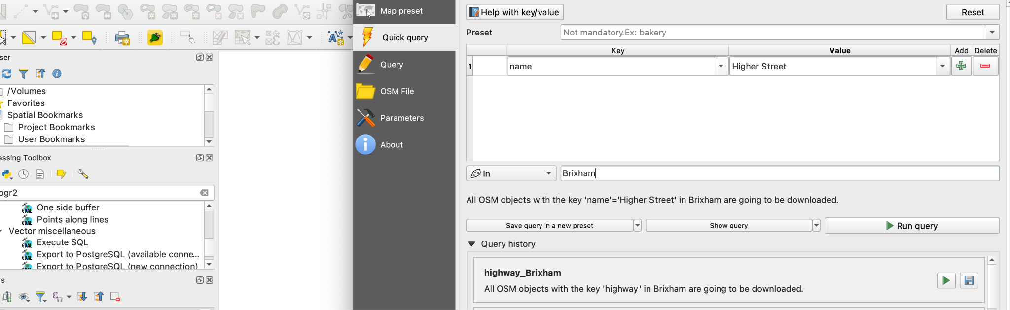
The “Swiss Army Knife”
Community Plugins
Your Plugins
Processing

Slide 13
Honourable Mentions
https://geojson.io/
https://mapshaper.org/
https://colorbrewer2.org
https://github.com/sshuair/awesome-gis

Slide 14
https://github.com/nautoguide/presentations

